Slide 1



What is Levi dickey Elementary School About?
No Excuses university, Avid & PBIS

Slide 3


Slide 4

What is No Excuses university (Neu)?

Slide 5
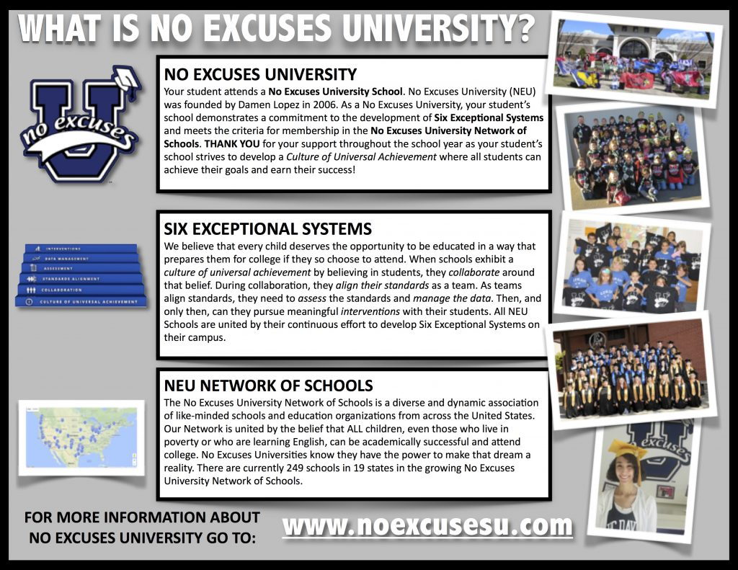
What is no excuses university?

Slide 6

What do we believe!

Slide 7

What is AVID?

Slide 8
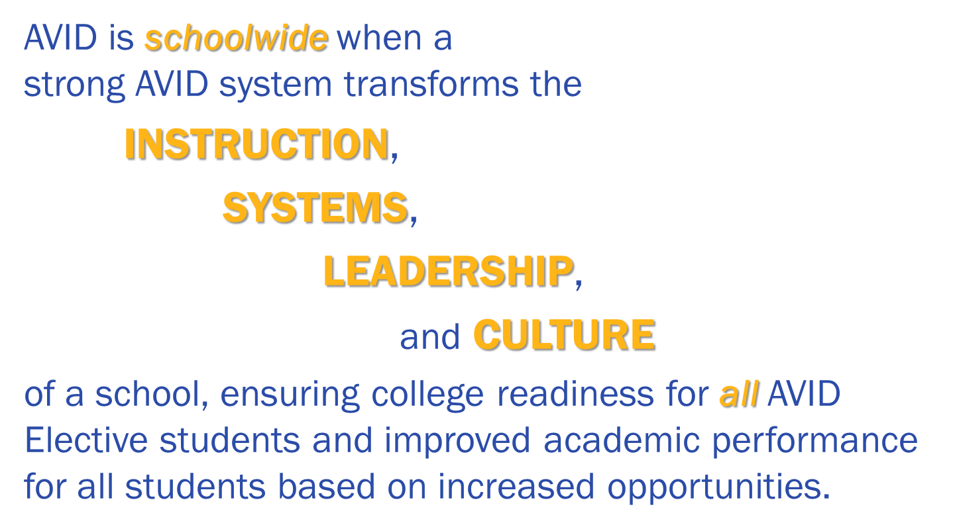

Slide 9
Avid
Advancement Via Individual determination
Collection of “best practices” embedded daily
Focus on organization and student responsibility
Philosophy of learning for all students
Teaching a growth mindset to ensure college readiness and career success

Slide 10
AVID Goals for the past year:
Notetaking
  3 Column Notes
Organization
  Agendas
  Binders
  Classroom Organization

Slide 11
Two and Three Column Notes Through the Grades:
Foundations Grades K-2 | Foundations Grades 3-6 |  | Bridges Grades 6-8
Teachers model the use of note-taking on anchor charts using 2/3-column format | Teachers model note-taking for students in 2- and 3- column format | Teachers provide direction and structure for notes | Teachers provide direction and structure for 2- or 3-column notes; may be ready for Cornell notes
Students interact with 2/3-column anchor charts | Students listen to think-aloud and copies notes | Student takes independent notes
Students use 2/3-column formats simplistically with letters and pictures | Notes all look identical, due to modeling | Content of notes varies by student | Content of notes varies by student; addition of statements/questions

Slide 12
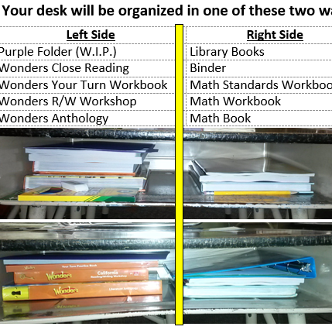
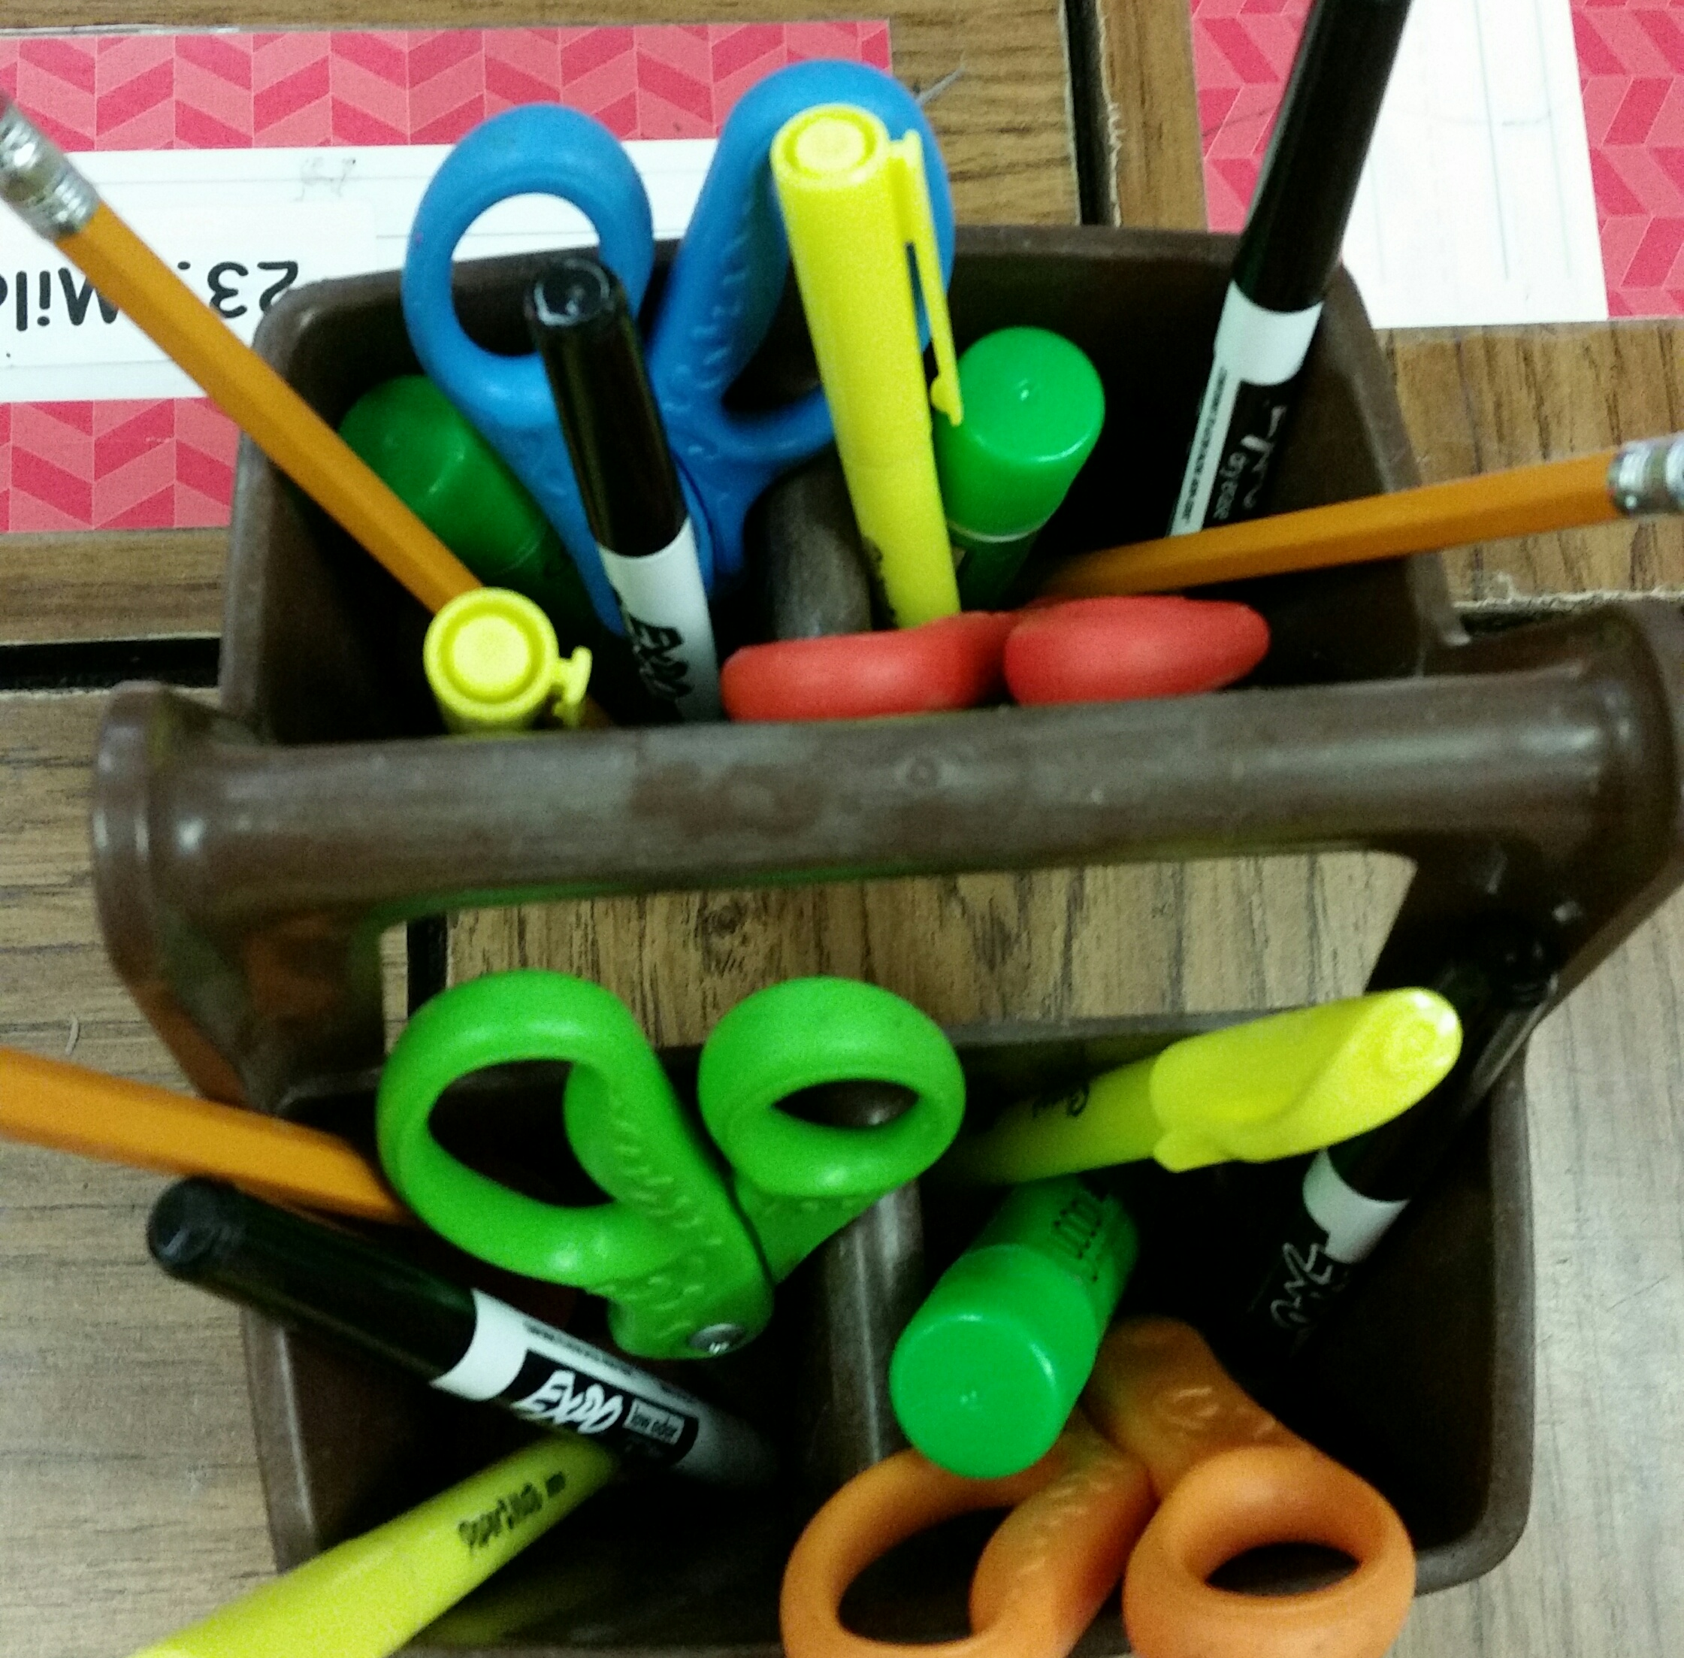
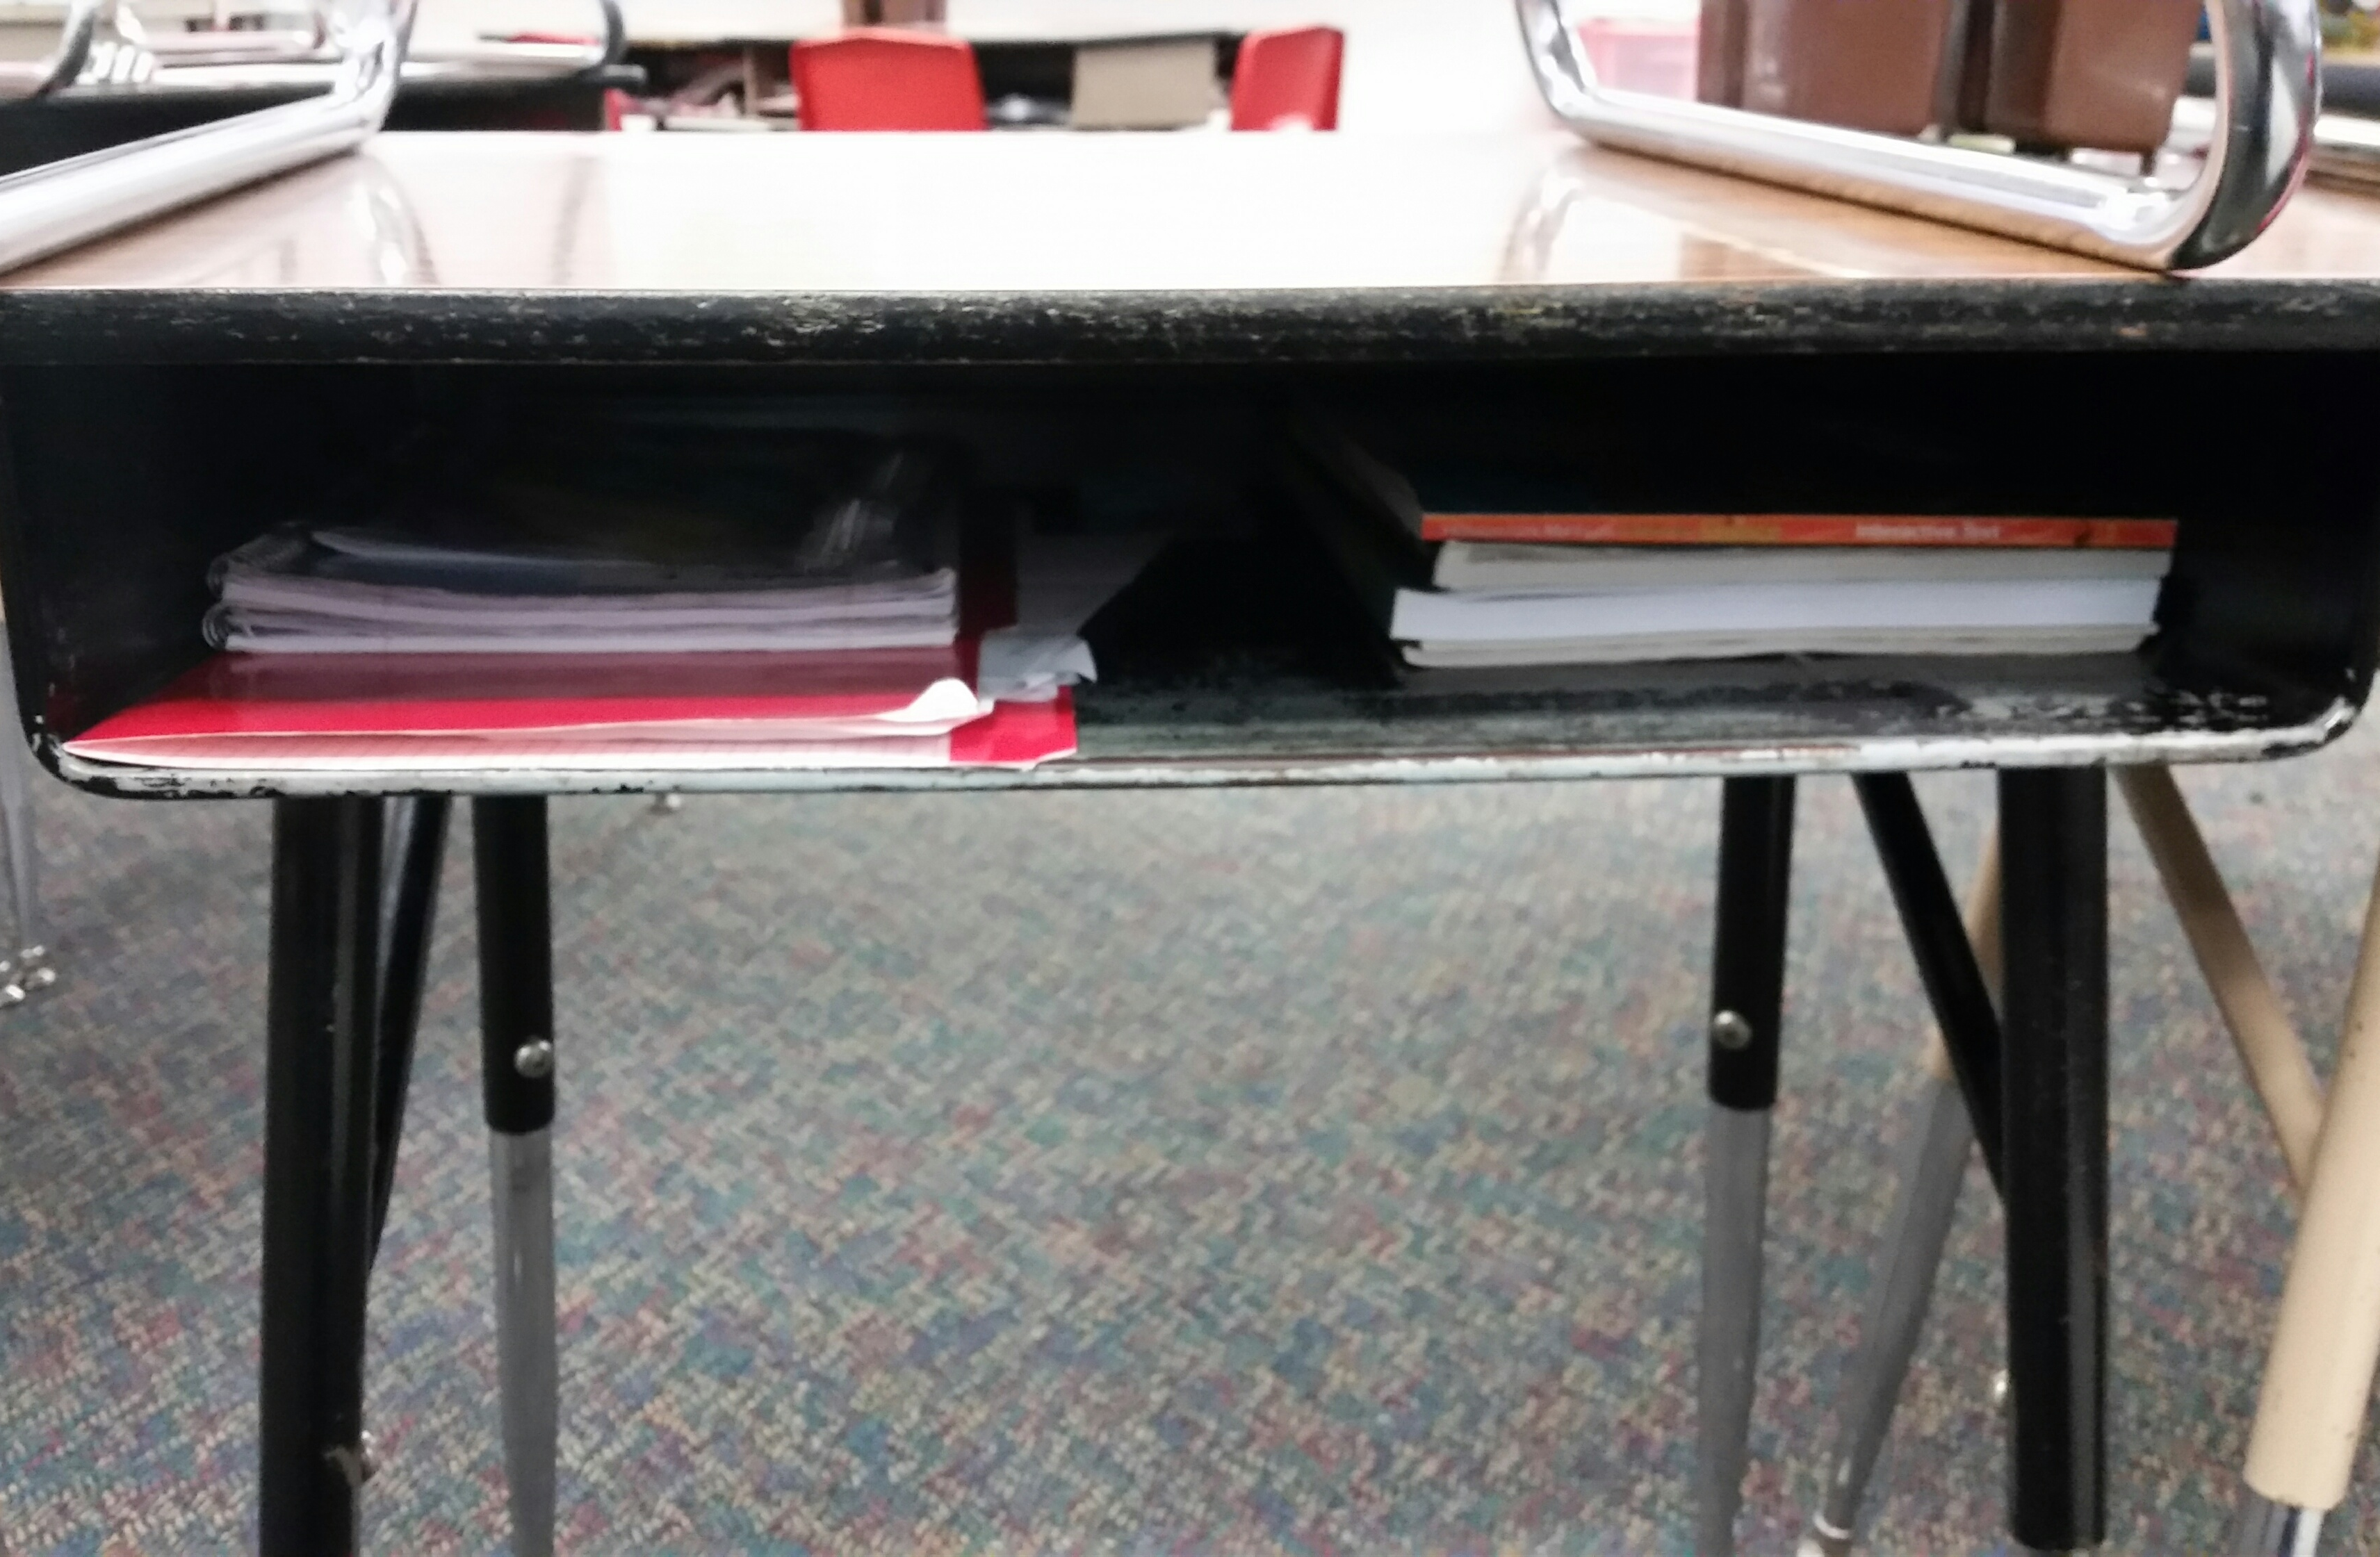
Organization

Slide 13

The Binder

Slide 14
What’s in the binder
Pencil Pouch: Post-It notes, eraser, colored pencils, blue correcting pen, extra pencil, highlighter
Levi Dickey Agenda (Agenda is written daily and signed nightly)
School Handouts Sheet Protector
5-Tabs that are color coded
Blue math spiral notebook and green ELA spiral notebook
Math tools sheet protector and ELA tools sheet protector
Binders go home and come back to school every day (except weekends)
Binder checks are conducted once every trimester (printed on blue paper)

Slide 15

Assessment tool
It is a checklist for teachers and students to keep track of their organization.
Can be used to self-monitor organization.

Slide 16
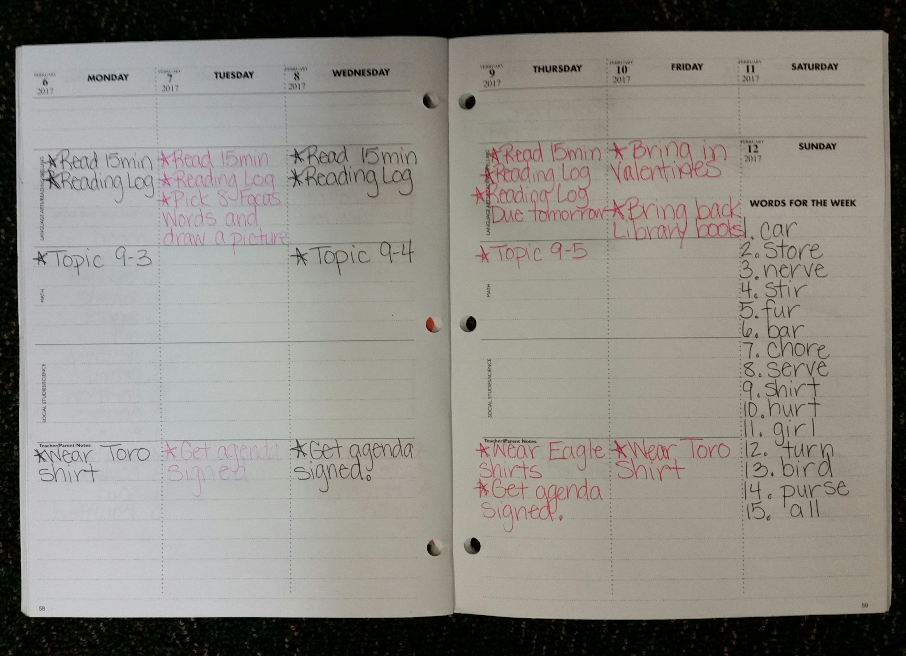
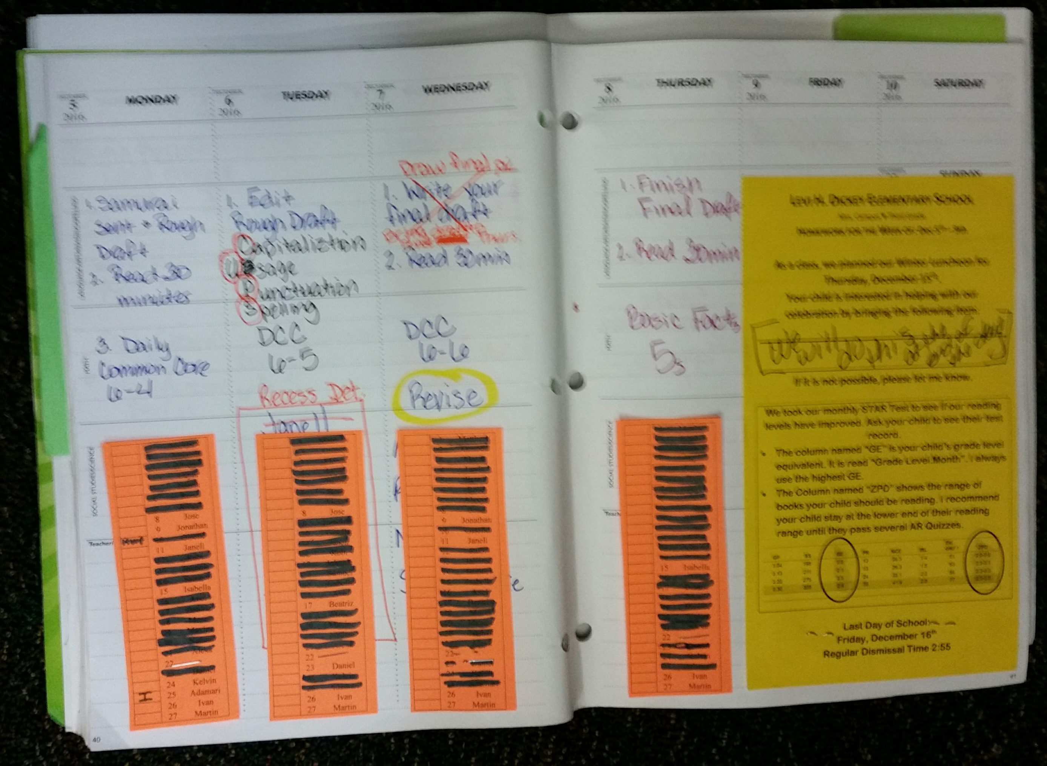
Agenda

Slide 17
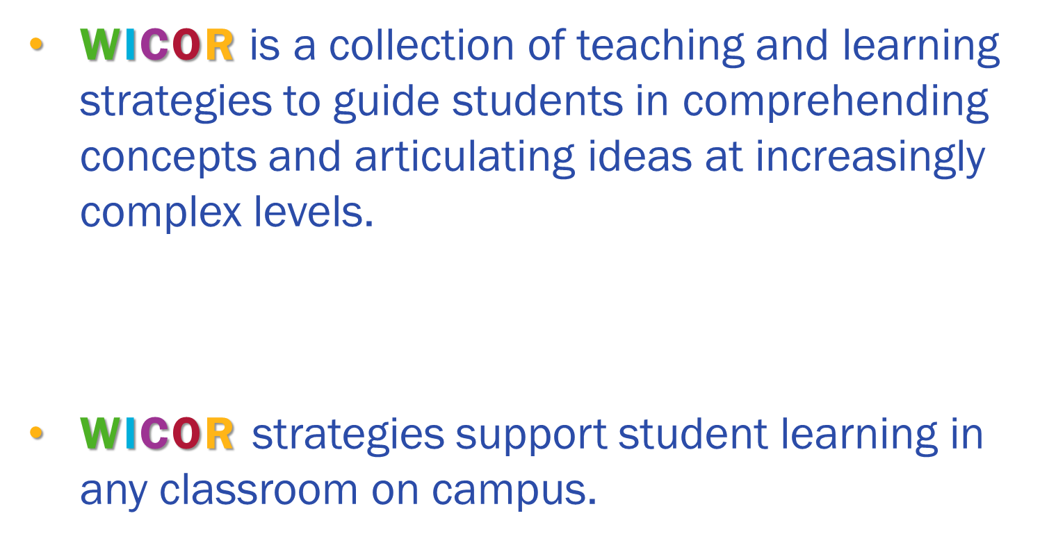

AVID Goals for this year:

Slide 18
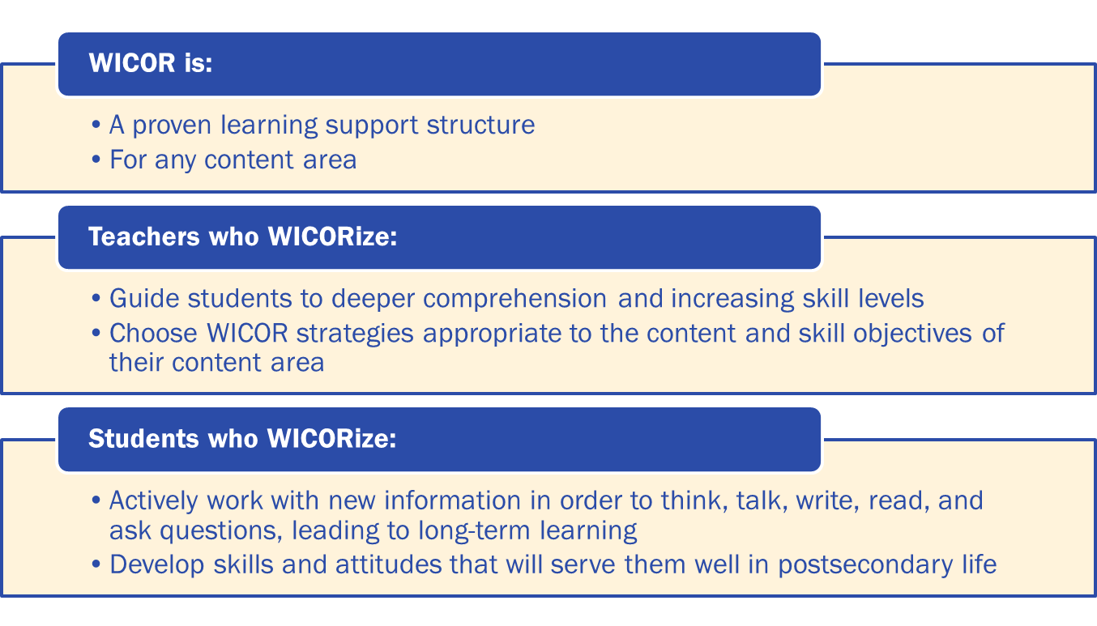
Why WICOR?

Slide 19
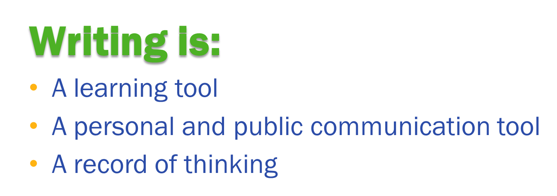
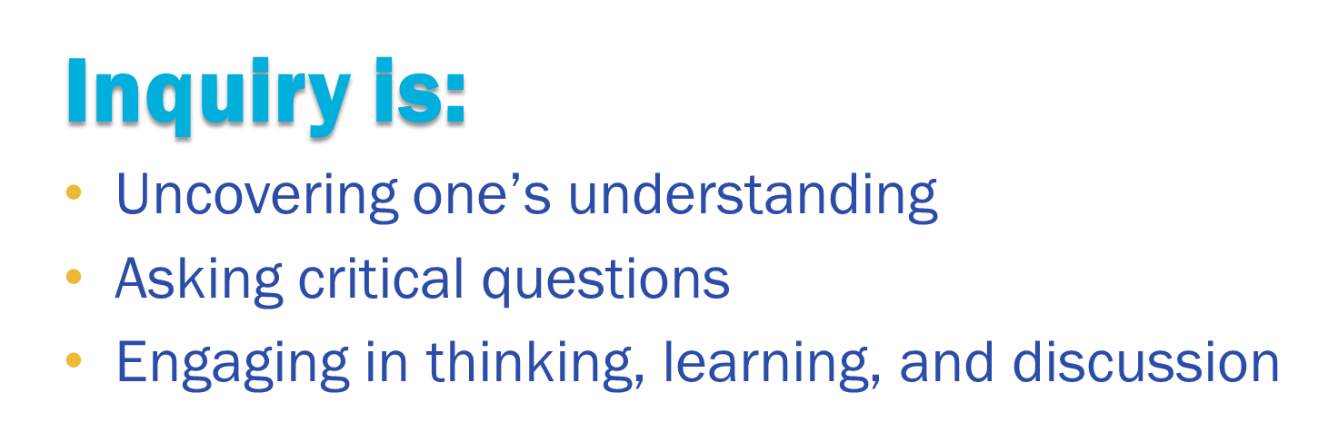

Slide 20
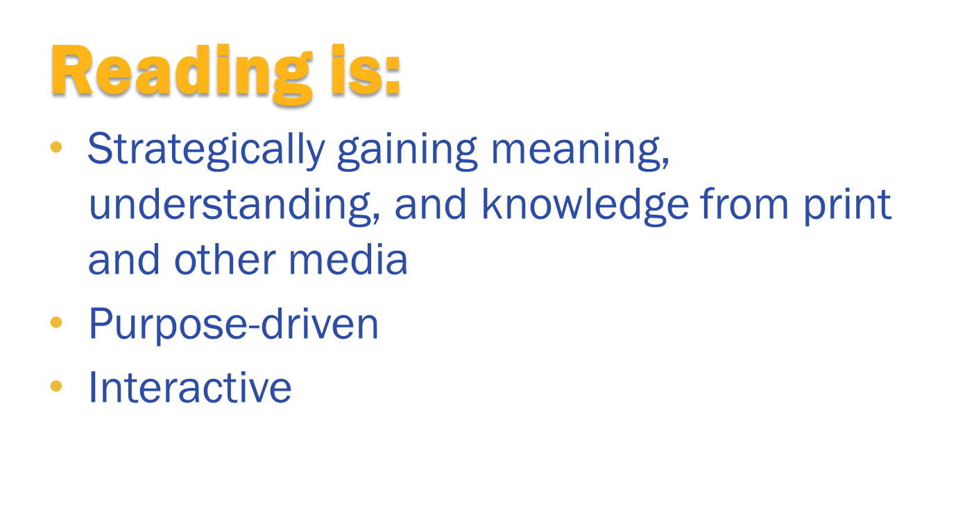

Slide 21
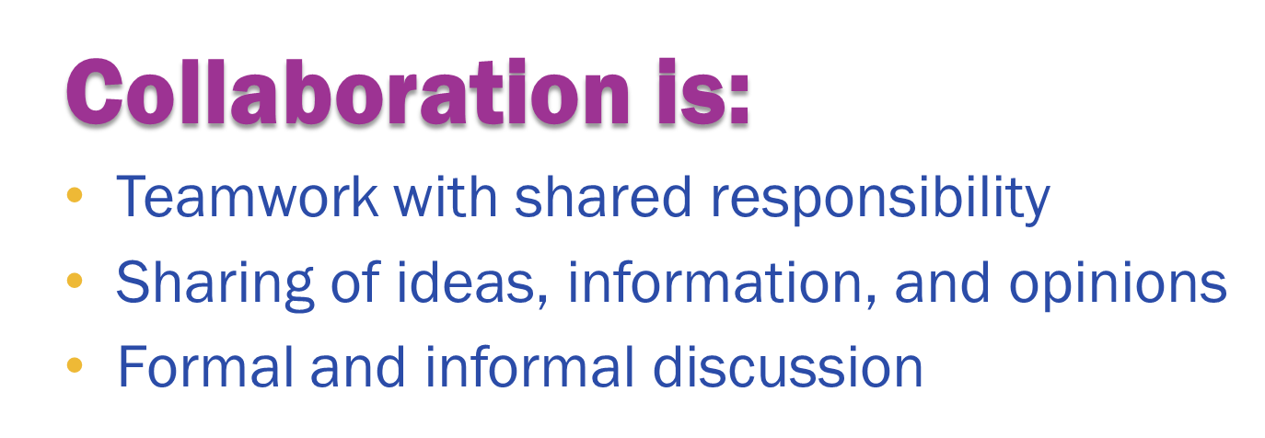
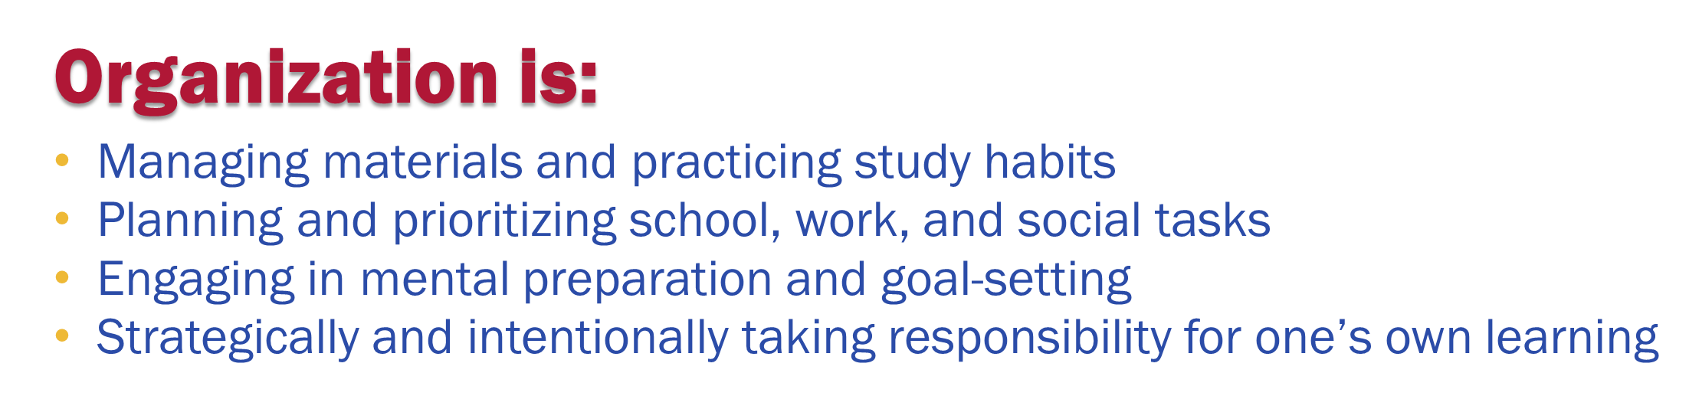

Slide 22

Why is this important?
CSU and UC A-G Requirements

Slide 23
What is Positive Behavior Interventions & Supports (PBIS)?

Slide 24
What Is PBIs?
Positive Behavioral Interventions and Supports
A way for schools to encourage good behavior
Prevention, not punishment
Kids will be more successful at meeting behavior expectations if they know what the expectations are.

Slide 25
Pbis in the classroom and around campus
Be Responsible, Be Respectful, Be Safe, Be College Ready
All classrooms post Classroom Expectations- showing examples of being respectful, responsible, safe and college ready
Expectations are posted in all areas around school
Expectations are taught the first 20 days of school
Classrooms follow organization and routines
Teacher language is focused on positive behaviors and students are rewarded for leading by example
Second Step lessons are taught throughout the school year

Slide 26
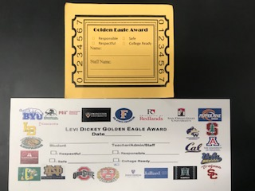
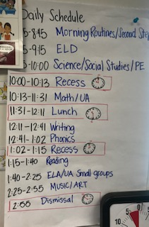
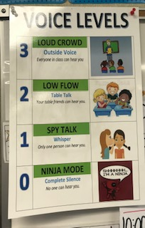
Pbis in the classroom and around campus

Slide 27
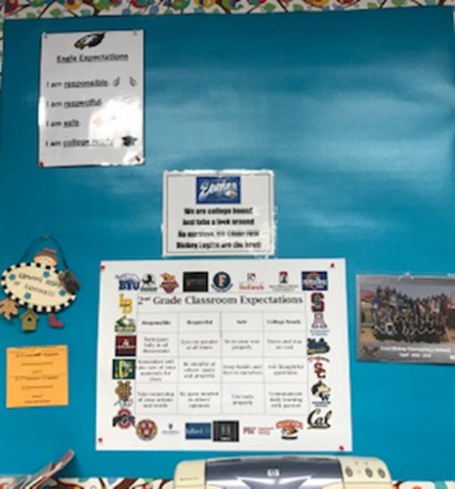
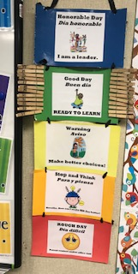
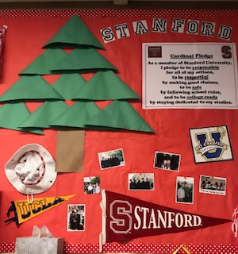
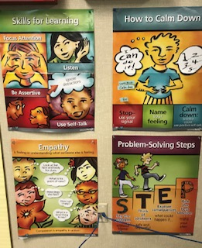
Pbis in the classroom and around campus

Slide 28
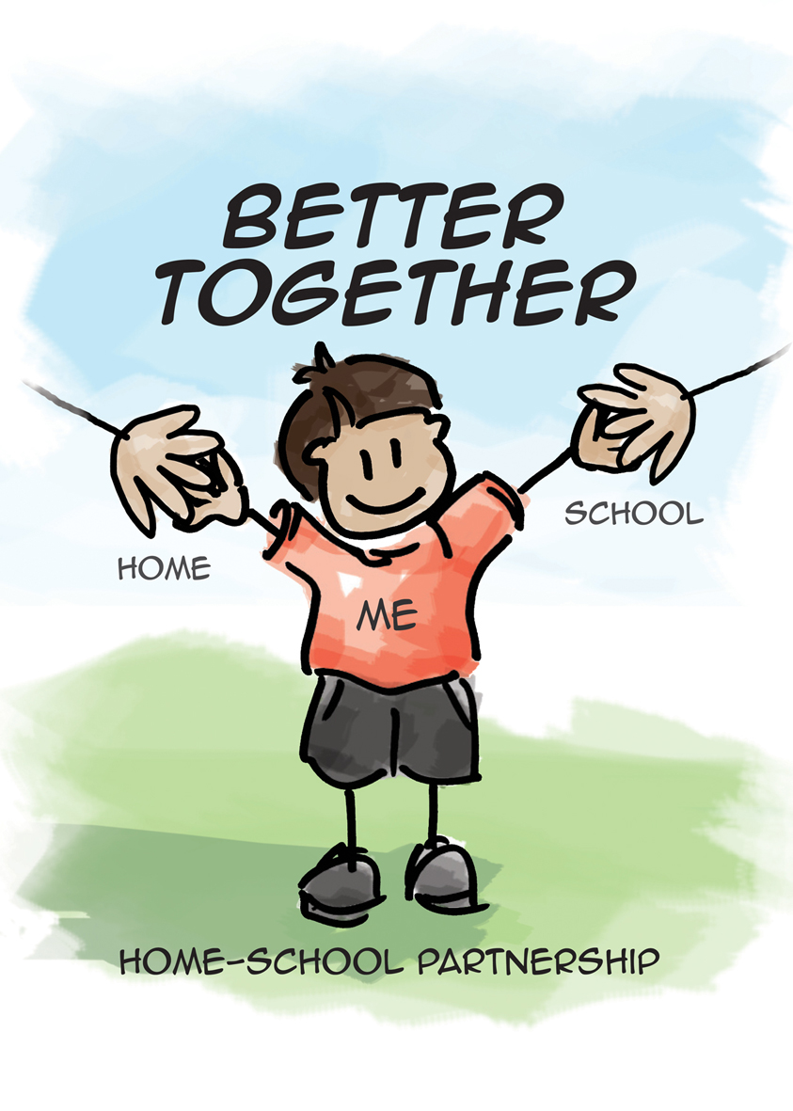
Pbis at home
Be Responsible, Respectful, Safe, College Ready
Be clear about expectations you have at home
Recognize positive behaviors, celebrate accomplishments

Slide 29
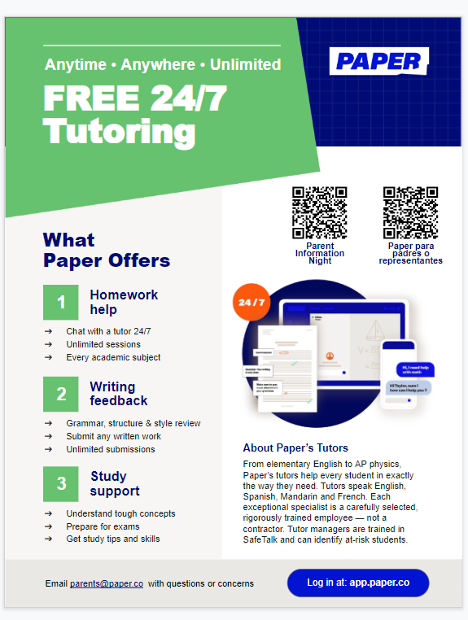
Paper

Slide 30

Questions…

